Slide 1
Salary prediction system
Presentation by
Jayesh Jadhav
Naveen kumar panse
Deepak mori
Lokendra Prajapati
Sahdev engla

Slide 2
introduction
Dataset : Employee experience vs salary data
Understand and clean the dataset
Identifying significant independent variables
Prediction using linear regression algorithm
Principle component analysis
Conclusions from our learning
Tools : Microsoft Excel and Python IDLE

Slide 3
About The Dataset
Dataset : : Employee experience vs salary data
Survey of employees for salaries on the basis of their experience
50 employees observations based on there experiences
Target variable Y (final salary)
Goal : To predict employees salary based on their experience using linear regression (supervised machine learning) algorithm

Slide 4
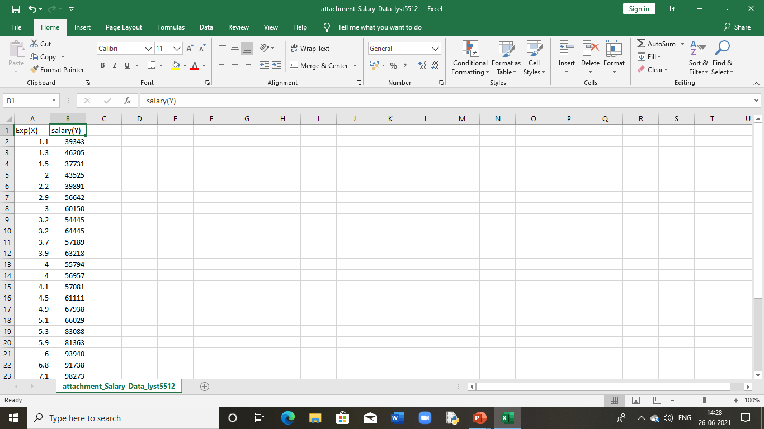
Dataset in ms excel

Slide 5
Regression
Well performed and accurate in both interpretation and prediction
Strong fundamental in math, statistics and computation
Many modern and advance methods are based on regression, even they are variant and regression
New methods are still invented for regression
“Nobel prize are still given to investigations in regression”.
Could be formulated as optimization problem :
“that’s the reason I choose it for this class, it’s more related to subject class than any other methods I have known for prediction”

Slide 6
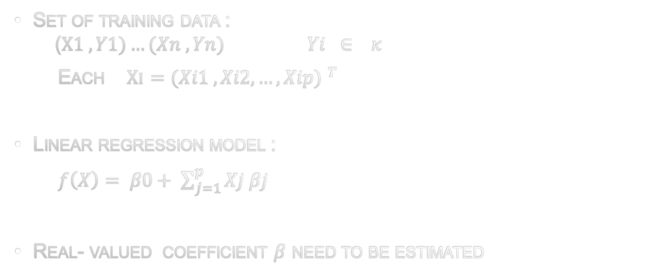
Linear regression
Set of training data : ($X1 , Y1)…(Xn , Yn)$ $Yi ∈ κ$
Each $Xi{=(Xi1 , Xi2,…,Xip) }^{T}$
Linear regression model :
$f\left(X\right)= β0+ \sum_{j=1}^{p}{Xj βj}$
Real- valued coefficient $β$ need to be estimated

Slide 7
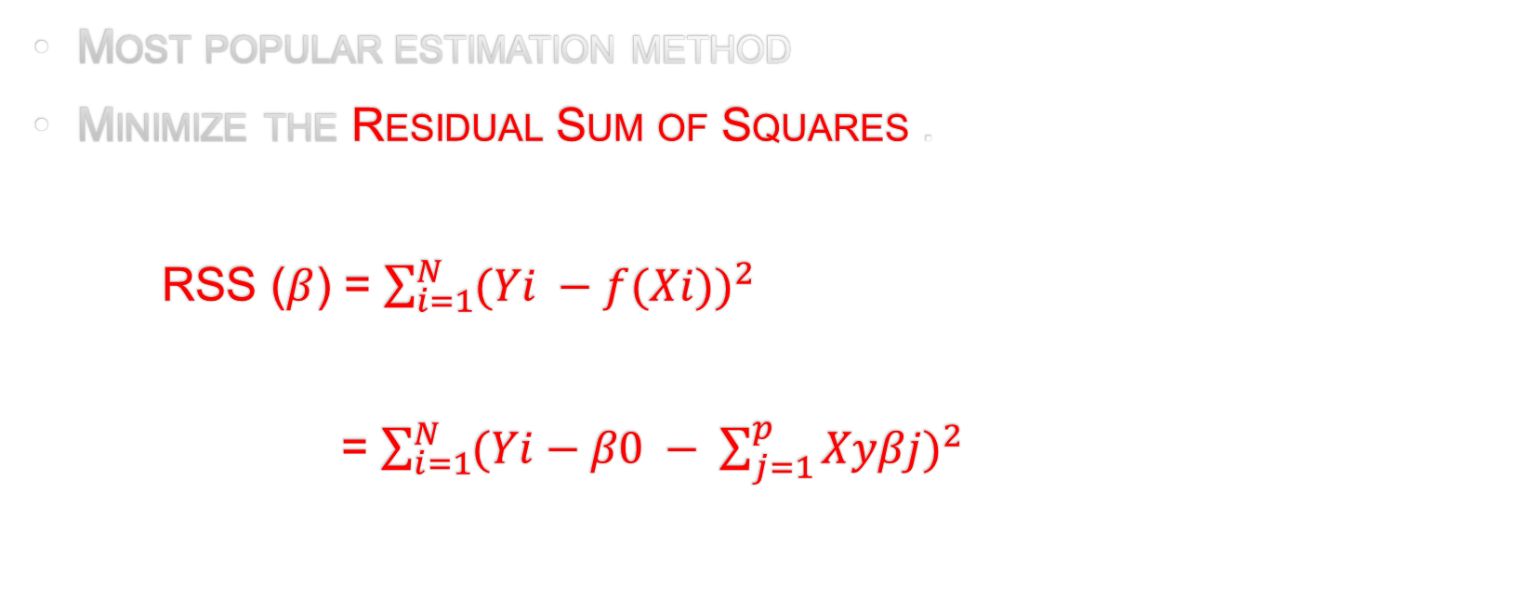
Linear regression least square
Most popular estimation method
Minimize the Residual Sum of Squares .
RSS ($β$) = $\sum_{i=1}^{N}{{(Yi −f(Xi))}^{2}}$
= $\sum_{i=1}^{N}{{(Yi−β0 − \sum_{j=1}^{p}{Xyβj})}^{2}}$

Slide 8
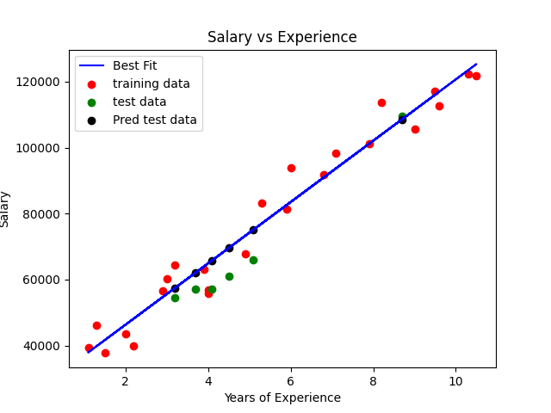
Linear regression example regression line

Slide 9
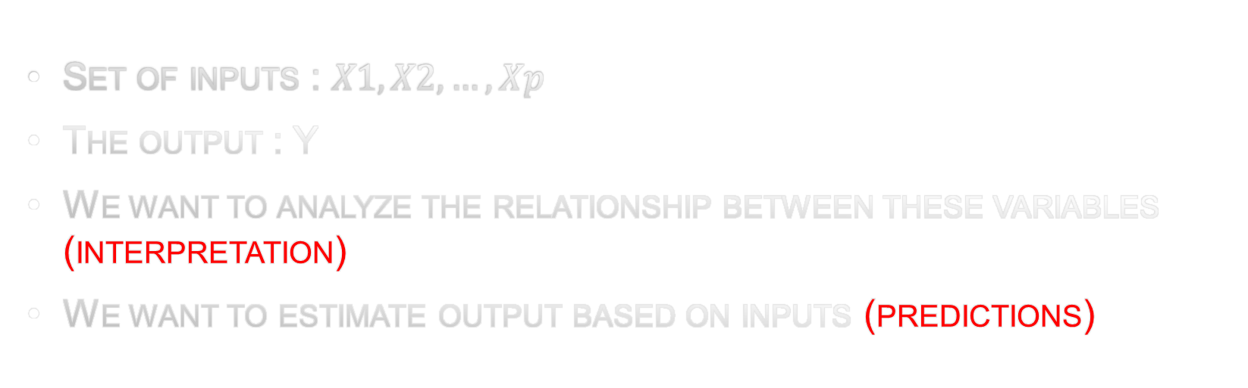
Prediction definition
Set of inputs : $X1, X2,…,Xp$
The output : Y
We want to analyze the relationship between these variables (interpretation)
We want to estimate output based on inputs (predictions)

Slide 10
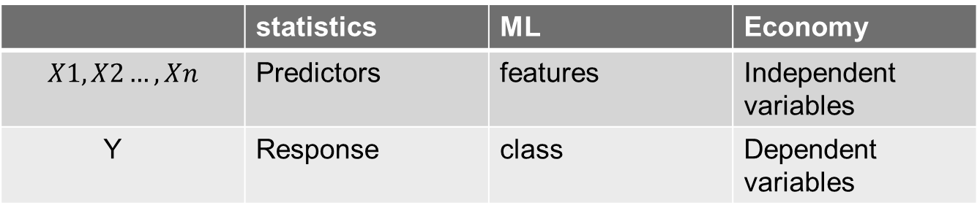
Prediction same concept in different literature
Machine learning: supervise learning
Experience : forecasting
Salary : prediction
Estimation theory : function approximation
 | statistics | ML | Economy
$$X1,X2…,Xn$$ | Predictors | features | Independent variables
Y | Response | class | Dependent variables

Slide 11
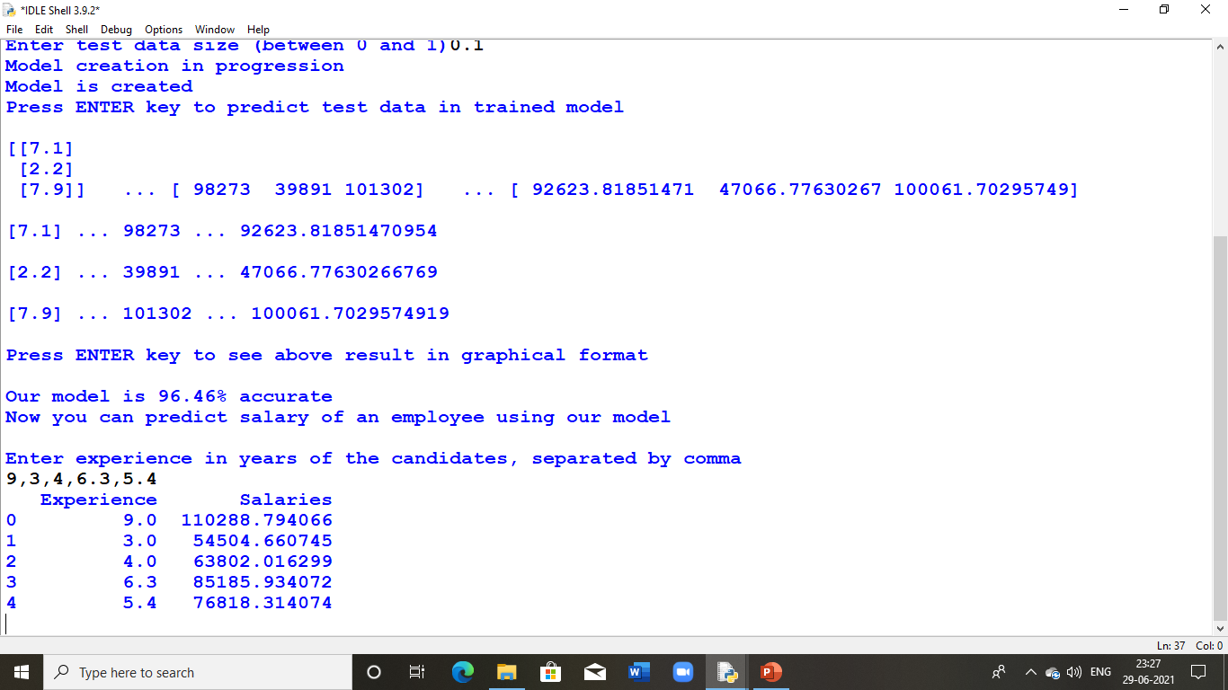
Actual Prediction of training , testing and random data

Slide 12
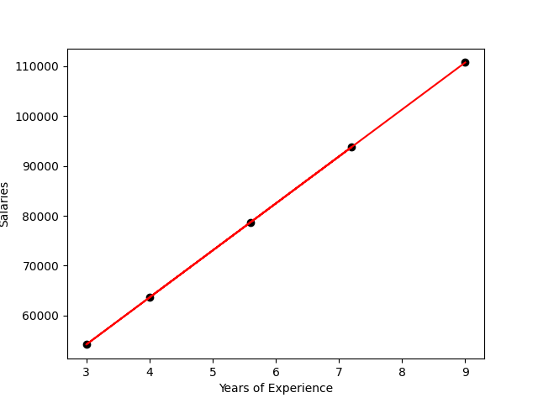
Graphical representation of random data

Slide 13
conclusion
Linear regression is powerful tool for numerical predictions
The idea is to fit a straight line through data points
Can extend to multiple directions
Can be used to predict discrete classes too

Slide 14
Thank you

